Slide 1
4 Types of Scrum Ceremonies
-by B.Manikarthik
P.Kavitha
D.Pratyusha
J.Gaurav

Slide 2
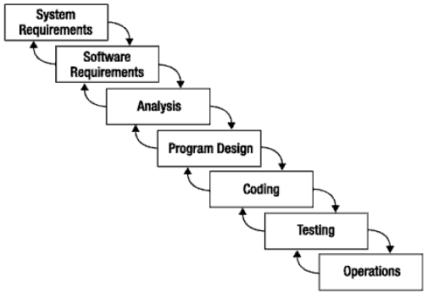
What is Scrum?
Is an agile, lightweight process
Can manage and control software and product development
Uses iterative, incremental practices
Has a simple implementation
Increases productivity
Reduces time to benefits
Embraces adaptive, empirical systems development
Is not restricted to software development projects
Embraces the opposite of the waterfall approach…

Slide 3
THANK YOU

Slide 4
Scrum Ceremonies:
Meetings or "ceremonies" are an important part of agile development.
They help to broadcast information to all team member, Bring common goal and vision, Share team progress appropriately.

Slide 5
Types of ceremonies:
Sprint Planning
Daily Stand-up
Iteration review
Retrospective

Slide 6
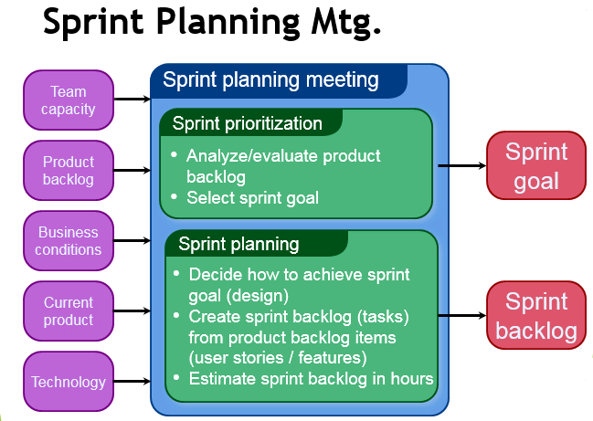

Slide 7
Why sprint planning is important?
The idea behind the sprint planning is to provide understanding between development and the customer when something new will be available, and to define the length of the feedback loop, which is equals to the length of the sprint.
In other words, the customer will know that He/she will get something in 2 weeks, which works, and the development team will know that they'll receive feedback on their work and know more about the upcoming work in two weeks. That's predictability.

Slide 8
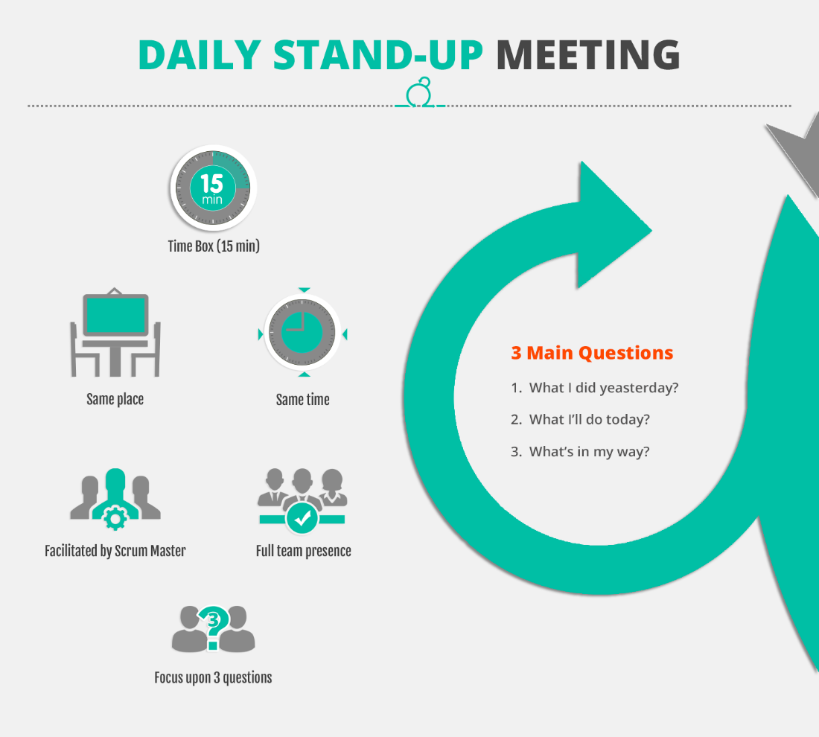

Slide 9
Key benefits
The team stays in sync with how the project is going.
There is an opportunity for swift course correction if needed.
By consistently committing and delivering, trust is built among team members.
Action can be taken with those who are consistently unable to make their commitments (not always pleasant, but usually necessary).

Slide 10
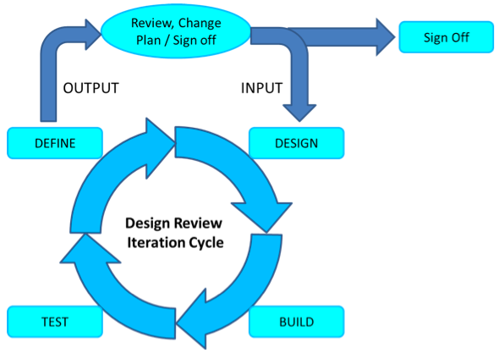
Iteration review

Slide 11
Why Iteration review is important?
The purpose of the iteration review is to measure the team’s progress by showing working stories to the Product Owner and other stakeholders to get their feedback.
The iteration review serves three important functions:
It brings closure to the iteration time box, to which many individuals have contributed to provide new value to the business.
It gives teams an opportunity to show the contributions they have made to the business and to take some satisfaction and pride in their work and progress.
It allows stakeholders to see working stories and provide feedback to improve the product

Slide 12
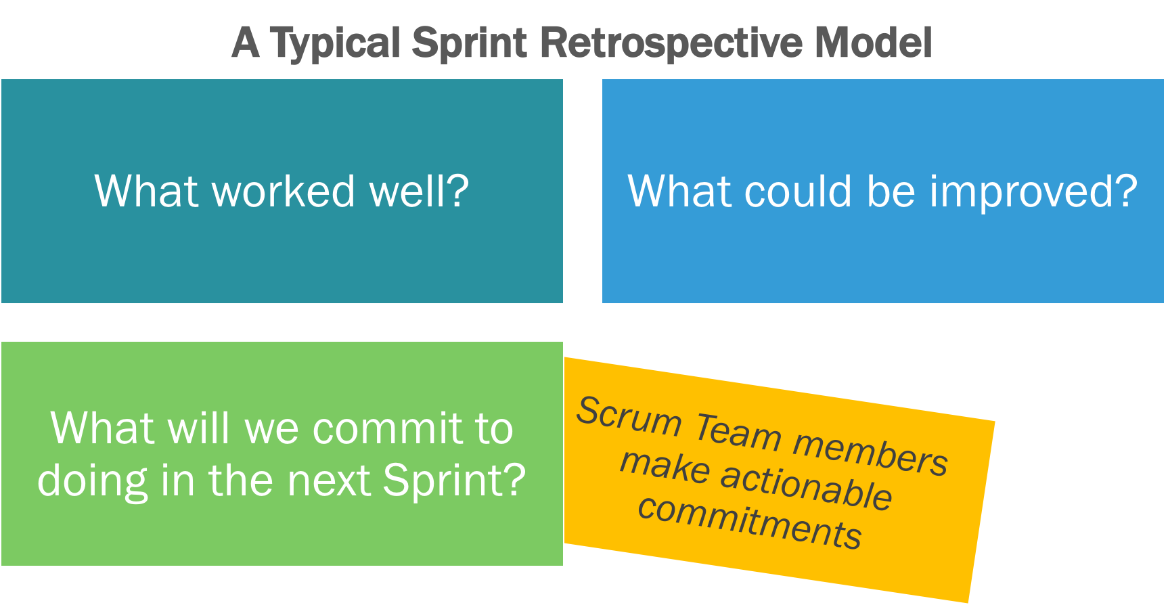
SPRINT RETROSPECTIVE
The retrospective is a collaborative process among all members, including the team, the product owner, and the Scrum Master.

Slide 13
Benefits of Retrospective:
Process improvements are made at the end of every sprint. This ensures that the project team is always improving the way it works.
All team members identify what went well and what could be improved.
The team members discuss the process that they are following and give any suggestions for improvement.
The team members discuss any other ideas that could improve their productivity.
The Scrum Master prioritizes actions and lessons learned based on team direction.
The retrospective supports team formation and bonding, particularly as any areas of conflict can be identified and dealt with.
The retrospective helps build the team’s sense of ownership and its self-management.

